Slide 1

Autonomous Mapping Robot
Worcester Polytechnic Institute
Department of Electrical and Computer Engineering
Advisor:
R. James Duckworth
Co-Advisor:
David Cyganski
Jason Ogasian
Jonathan Hayden
Hiroshi Mita

Slide 2
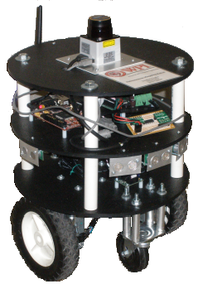
Overview
Project motivation
Background material
Robot functional overview
Design requirements
The chassis
System electronics
Onboard sensors
Software implementation
Video demonstration of robot
Results and Recommendations

Slide 3
Project Motivation
Establish a need: search and rescue
How will the project fill this need?
Time and budget constraints
Leave room for future expansion
Allow room for additional functionality
Provide recommendations for future work

Slide 4
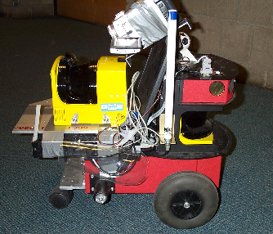
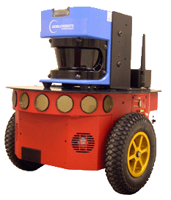
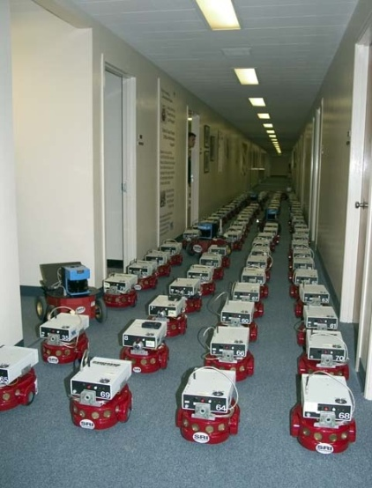
Background
Existing mapping robots
CMU 3D texture mapping
MobileRobots’ Mapperbot
Centibots
Commonalities with our design
3D texture mapping robot
Mapperbot
Centibots project

Slide 5
Robot Functional Overview - System Requirements -
Project goal: Atwater Kent 3rd floor
Autonomous operation
Sufficient battery life/efficiency
Capable microprocessor
Wireless communication
Host software: Mapping GUI

Slide 6
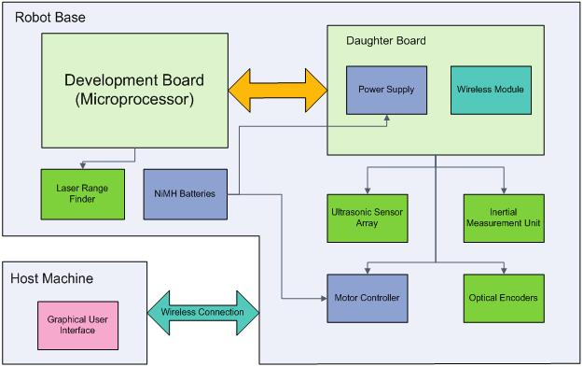
Robot Functional Overview - High-level Diagram -

Slide 7
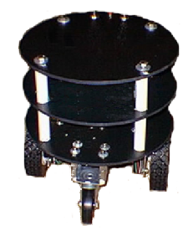
Robot Functional Overview - Robot Chassis -
Requirements
Size
Wheels
Motors
Purchasing vs. building
Focus on ECE aspects of design
Zagros Robotics:
Max ’99 Mobile Robot Base.

Slide 8
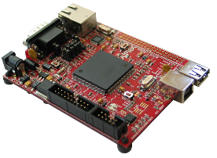
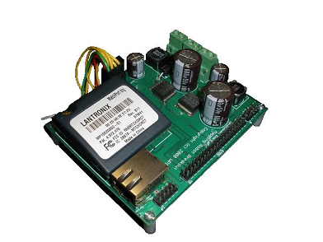
Robot Functional Overview - System Electronics -
Development board
Microprocessor (Linux)
USB and Ethernet
Custom PCB
Power circuitry
Wireless module
Interface sensors with development board
Olimex SAM9-L9260
Custom PCB

Slide 9
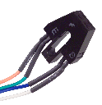
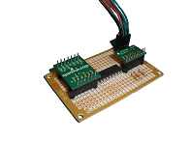

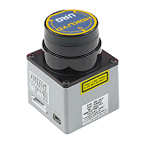
Robot Functional Overview - Onboard Sensors-
Onboard Sensors
Optical encoders
Dead reckoning
Inertial Measurement Unit
Accelerometer and Gyroscope
Ultrasonic sensors
Short-range navigation
Laser Rangefinder
Mapping
Fairchild QRB1134
Custom IMU
Devantech SRF05
Hokuyo URG-04LX Laser

Slide 10
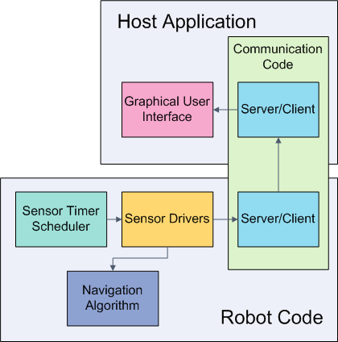
Robot Functional Overview - Software Implementation -
Communication code
Socket API
Robot code
Sensor scheduling
Sensor drivers
Navigation algorithm
Host application
Graphical user interface
Real-time Operation

Slide 11
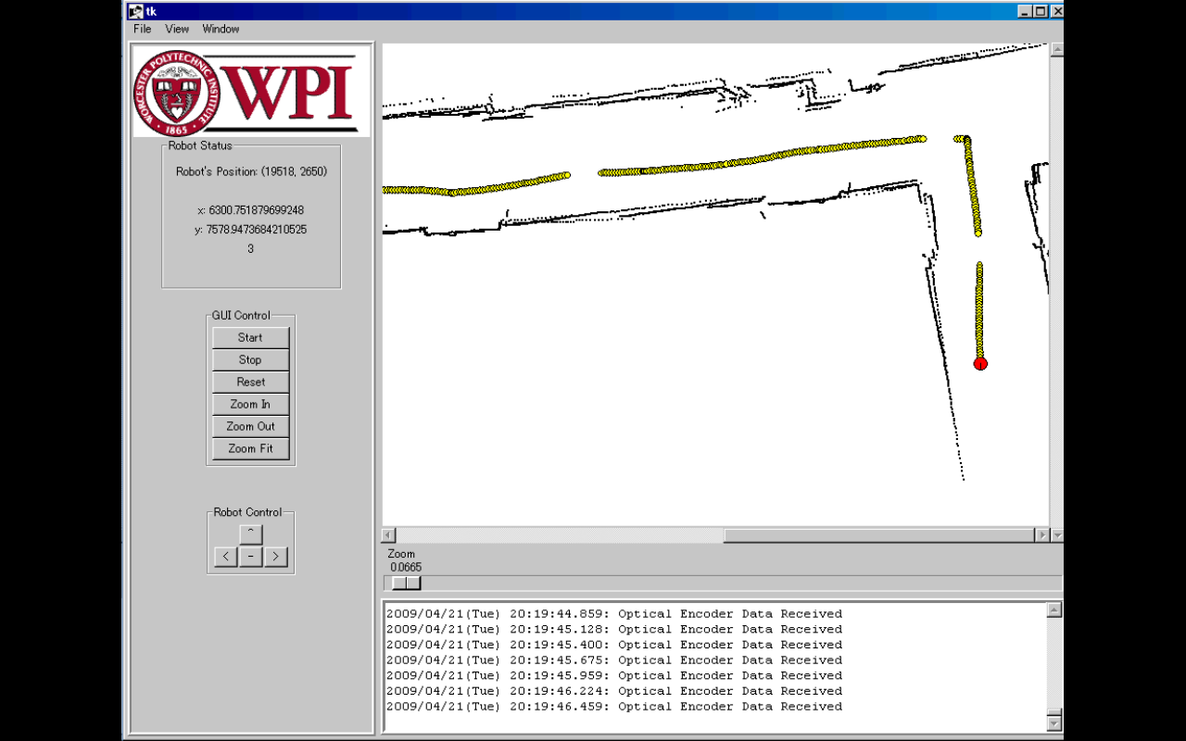
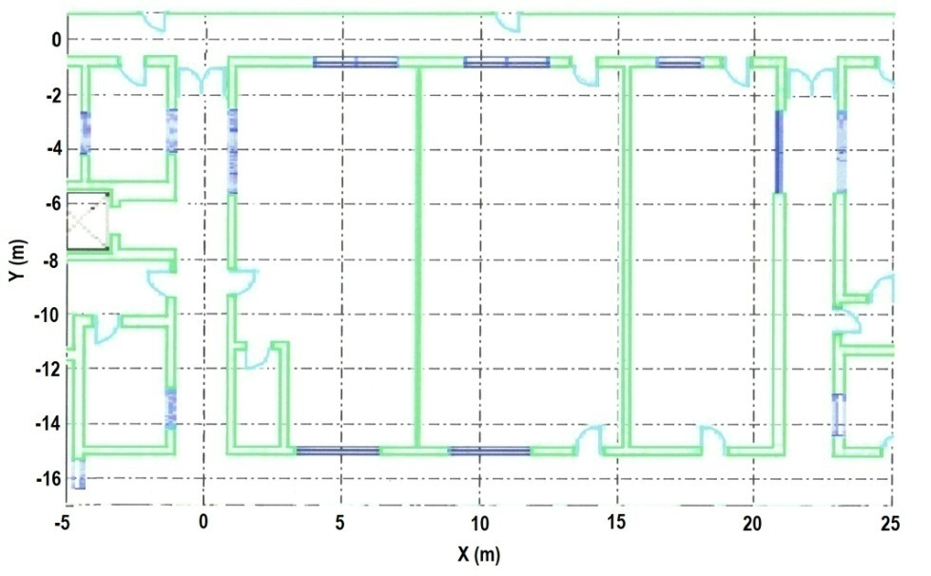
Graphical Map Display

Slide 12
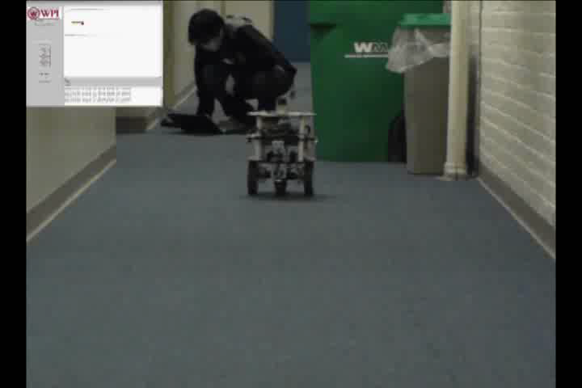
Video Demonstration

Slide 13
Results and Recommendations
Final product capabilities
Autonomous operation
Wireless data transfer
GUI map displayed to user
Systems working together to generate a map
Positional data error of 5.6%
Suggestions for future work
Human detection capability
More robust chassis
Improved navigation algorithm

Slide 14
Acknowledgements
Thanks to:
Professors Duckworth and Cyganski
ECE Shop
WPI Department of Electrical and Computer Engineering

Slide 15
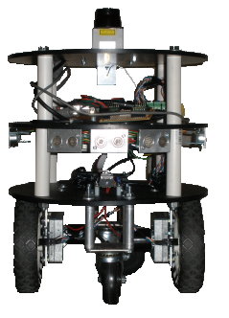
Questions?

